Slide 1
Simulation of cell growth
Types of cell – 1 (cancer)

Slide 2
Part 1 : Distribution of free Space, Number of Cells, Surface heterogeneity, and volume heterogeneity against time(mcs)

Slide 3
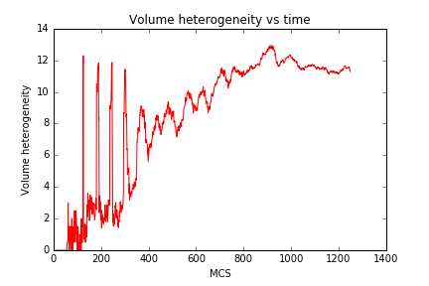
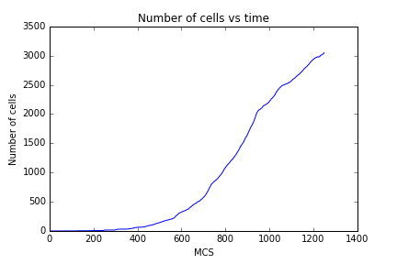
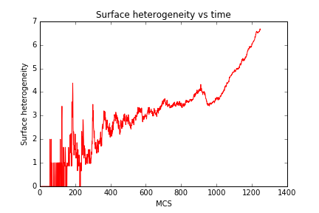
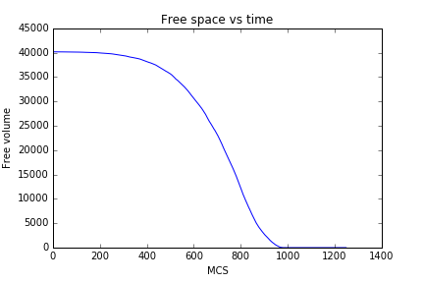
Square Plate ( Area – 40000 )

Slide 4
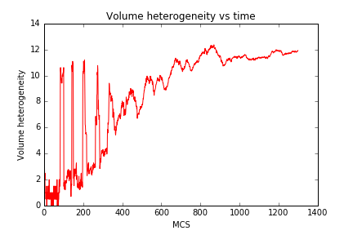
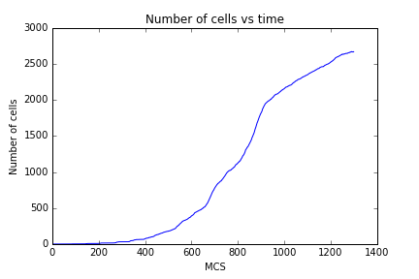
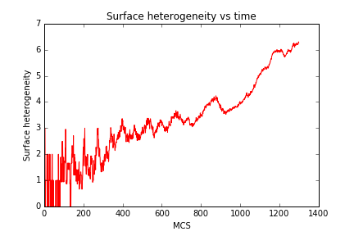
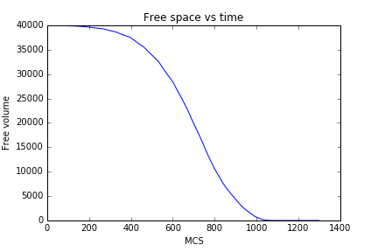
Triangular plate ( Area – 40000)

Slide 5
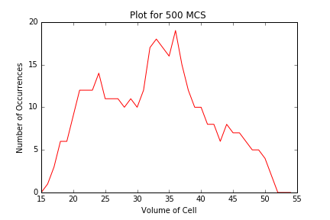
Distribution of number of cells over volume

Slide 6
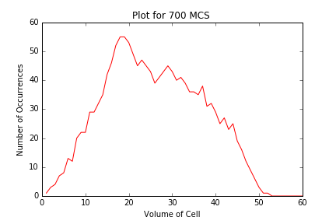
Distribution of number of cells over volume (averaged over 10 simulations of 700 monte carlo steps)

Slide 7
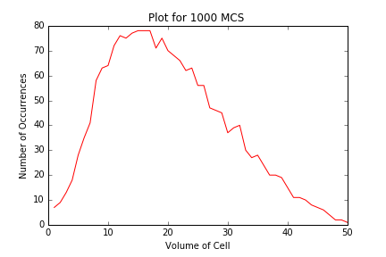
Distribution of number of cells over volume (averaged over 10 simulations of 1000 monte carlo steps)

